Slide 1



FlowXpert: Expertizing Troubleshooting Workflow Orchestration
with Knowledge Base and Multi-Agent Coevolution
Binpeng Shi¹, Yu Luo¹, Jingya Wang¹, Yongxin Zhao¹, Shenglin Zhang¹, Bowen Hao¹, Chenyu Zhao¹, Yongqian Sun¹, Zhi Zhang², Ronghua Sun², Haihua Li², Wei Song², Xiaolong Chen², Jingbo Miao², Dan Pei³
¹Nankai University, ²Huawei, ³Tsinghua University
Reporter: Binpeng Shi
Email: shibinpeng23@mail.nankai.edu.cn

Slide 2
Outline
What are the typical resolutions for a cloud incident?
➔ Workflow, step-by-step guidance and executable scripts
How to transform a naive LLM into a workflow generator in the field of cloud services?
➔ Support of domain knowledge, alignment of application capability
Framework design
➔ Knowledge Base Construction, Multi-Agent Coevolution
Evaluation
➔ Benchmark tests, online deployment, case study

Slide 3






Impact of Incidents
Incidents → Unsatisfying customers → Economic loss

Slide 4
Typical Resolutions for Cloud Incidents
Step-by-step guidance
Executable scripts
AI agent equipped with tool invocation and result analysis capabilities
Most cloud service providers abstract troubleshooting into workflows, which follow a structured sequence of core steps

Slide 5
Workflow Usage and Acquisition
Heavy Usage
Difficult Acquisition
Workflow Recommendations Based on Similar Cases
Automated Incident Execution and Analysis
For a workflow: 7 Hours + 7 OCEs
Including contributions from 2 experts
Workflows play a critical role in troubleshooting, which urgently needs to shift from manual creation to automated orchestration

Slide 6
Outline
What are the typical resolutions for a cloud incident?
➔ Workflow, step-by-step guidance and executable scripts
How to transform a naive LLM into a workflow generator in the field of cloud services?
➔ Support of domain knowledge, alignment of application capability
Framework design
➔ Knowledge Base Construction, Multi-Agent Coevolution
Evaluation
➔ Benchmark tests, online deployment, case study

Slide 7
Design Motivation
From naive LLM to workflow generator

Slide 8
Challenges in the Transformation Process
Transformation
Knowledge Support
Application Alignment
Complexity
Compliance
Reliability
of troubleshooting expertise
of workflow orchestration with domain requirements
of AI
feedback

Slide 9
Outline
What are the typical resolutions for a cloud incident?
➔ Workflow, step-by-step guidance and executable scripts
How to transform a naive LLM into a workflow generator in the field of cloud services?
➔ Support of domain knowledge, alignment of application capability
Framework design
➔ Knowledge Base Construction, Multi-Agent Coevolution
Evaluation
➔ Benchmark tests, online deployment, case study

Slide 10
FlowXpert Overview
A Framework dedicated to transforming
naive LLMs into high-quality workflow generators

Slide 11
FlowXpert - Module#1
Module #1 Knowledge Base Construction

Slide 12
FlowXpert - Module#1
Module #1 Extract Incidents from Chunks

Slide 13
FlowXpert - Module#1
Module #1 Fill in Incident-Aware Nodes

Slide 14
FlowXpert - Module#1
Module #1 Merge and Refine Nodes across Chunks

Slide 15
FlowXpert - Module#2
Module #2 Multi-Agent Coevolution

Slide 16
FlowXpert - Module#2
Module #2 PPO for Planner

Slide 17
FlowXpert - Module#2
Module #2 DPO for Scorer

Slide 18
Outline
What are the typical resolutions for a cloud incident?
➔ Workflow, step-by-step guidance and executable scripts
How to transform a naive LLM into a workflow generator in the field of cloud services?
➔ Support of domain knowledge, alignment of application capability
Framework design
➔ Knowledge Base Construction, Multi-Agent Coevolution
Evaluation
➔ Benchmark tests, online deployment, case study

Slide 19
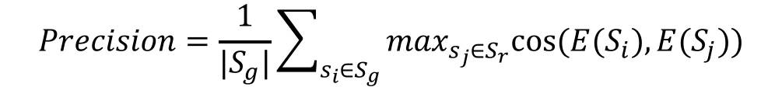
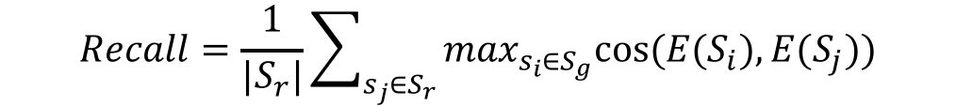
Evaluation: Dataset and Metric
Evaluation Dataset:
From operation documents of Huawei Cloud’s datacenter network (DCN team)
252 user queries and their corresponding standard workflows
4 domains: hardware, interface, network, top
Metric:
We propose STEPScore as a tailored metric
The Precision indicates how closely the generated steps match the standard steps.
The Recall indicates how well the standard steps are retrieved in the generated steps.
$$Precision=\frac{1}{|S_{g}|}\sum_{s_{i}∈S_{g}}{\max_{s_{j}∈S_{r}}cos⁡(E(S_{i}),E(S_{j}))}$$
$$Recall=\frac{1}{|S_{r}|}\sum_{s_{j}∈S_{r}}{\max_{s_{i}∈S_{g}}cos⁡(E(S_{i}),E(S_{j}))}$$

Slide 20
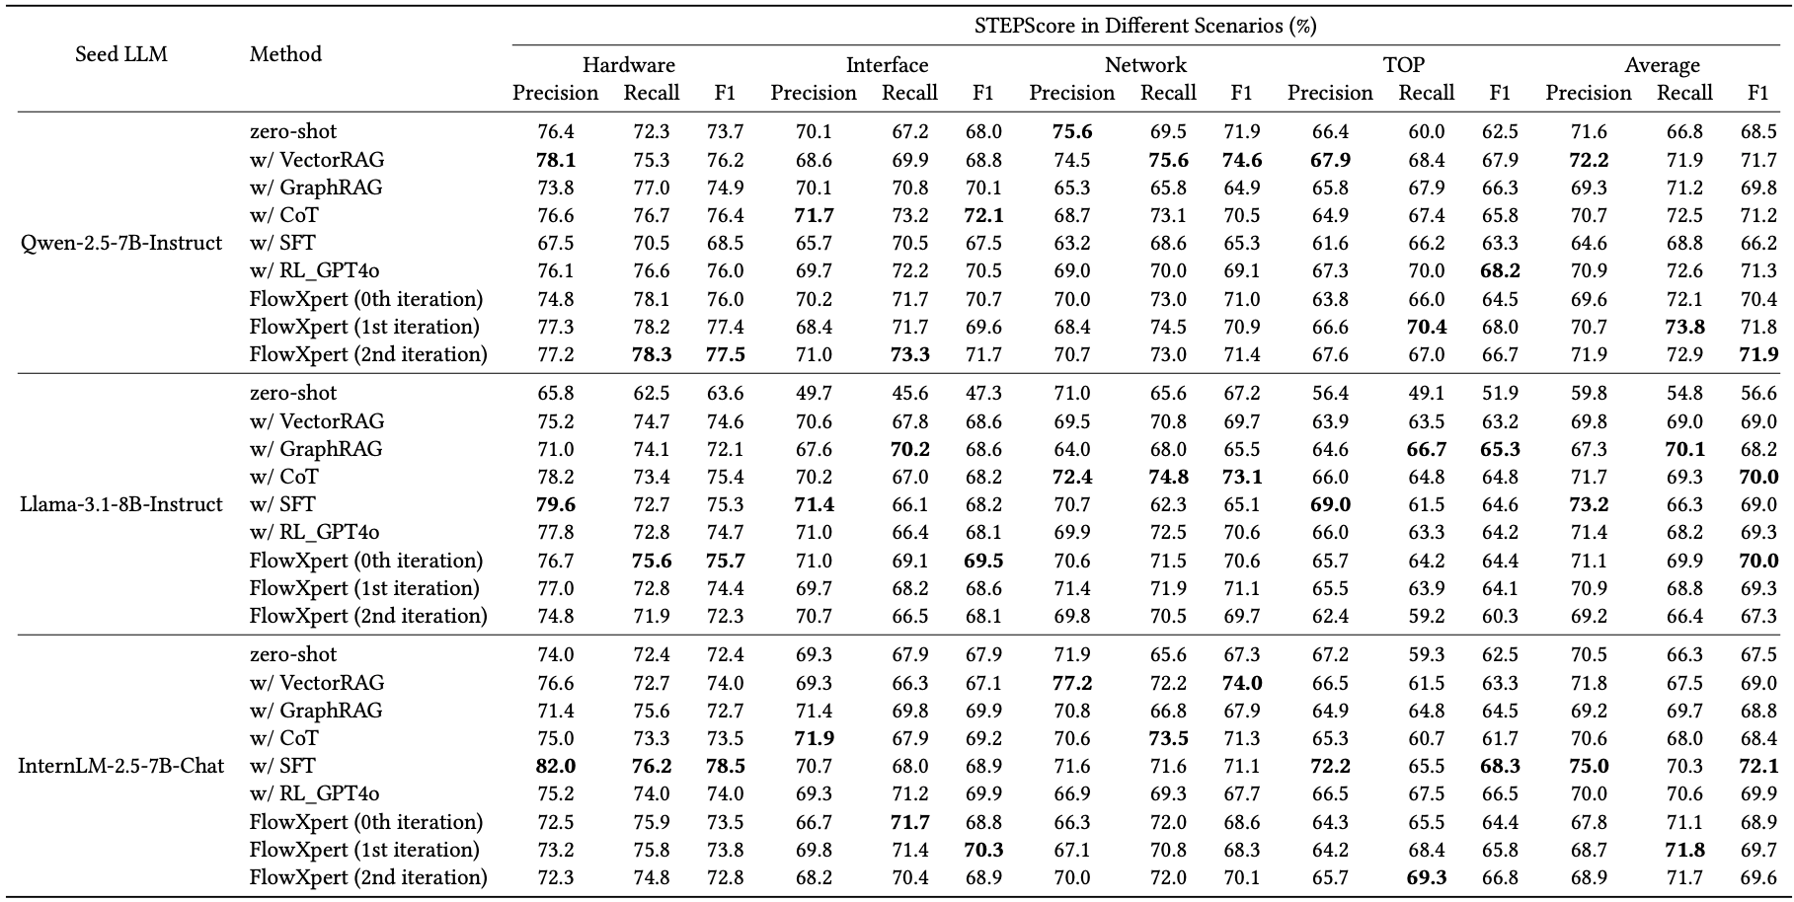
Evaluation: Overall Performance

Slide 21

Online Deployment: For OCEs
For OCEs: (1) A 10-week deployment in Huawei Cloud DCN, 189 common incident types, 34K incident tickets; (2) average 22.1 seconds for a workflow v.s. 7-hour effort of a 7-person OCE team, including 2 experts.

Slide 22
Case Study: For AI Executors
For AI Executors: A case study of autonomous AI Executor for incident handling.

Slide 23
Future Directions
Novel Incident Handling: …
Quality of Retrieved Knowledge: …
Execution Constraints: …

Slide 24

Takeaways
We propose FlowXpert, a framework that orchestrates troubleshooting workflows by integrating domain knowledge support and aligned knowledge application. Specifically, we (1) define a domain ontology to guide the knowledge base construction, (2) implement multi-agent coevolution through PPO and DPO tuning, (3) design a preference data synthesis method controlled by contextual richness.
We introduce STEPScore, a metric designed around core characteristics of workflows, and conduct extensive benchmark tests based on real-world incidents from Huawei Cloud DCN team.
In production of DCN, our framework contributed a lot to both OCEs and Executors.

Slide 25
Thank you!
Reporter: Binpeng Shi
Email: shibinpeng23@mail.nankai.edu.cn

